Slide 1


ML MINIPROJECT
Shreyas Sudeer - 210962001
Bhavana Kedari - 210962038

Slide 2
Problem Statement
Prediction of disease outbreak using social media data
In todays world, there is the present need for accurate and timely predictions of disease outbreaks especially after the outbreak of COVID-19. Traditional methods of monitoring often rely on slow data collection processes hindering the rapid response. The emergence of social media coupled with advanced machine learning techniques offers a unique opportunity to revolutionize infectious disease tracking

Slide 3
Objectives
Develop a robust model using machine learning techniques to predict percentage disease outbreak using social media trends.
To provide valuable insights for public health interventions and strategies.
Leveraging machine learning techniques for real-time monitoring of disease outbreaks.

Slide 4
Literature Review
[1] Brownstein et al. (2009) - Twitter Data for H1N1 Monitoring:- *Approach:* - Multifaceted approach: social network analysis, NLP, machine learning.- *Methods:* - Social network analysis identified clusters discussing H1N1. - NLP extracted symptoms, locations, transmission patterns. - Machine learning models classified tweets for rapid analysis.- *Advantages:* - Real-time monitoring. - Contrasts with slower traditional methods.- *Findings:* - Twitter data valuable for real-time disease tracking. - Efficacy in identifying and characterizing H1N1 spread.
[2] Signorini et al. (2011) - Social Media for Stock Market Prediction:- *Approach:* - Diverse machine learning techniques for stock market prediction.- *Methods:* - SVMs for sentiment classification, Naive Bayes for stock movements. - Ensemble methods combined insights for enhanced performance.- *Advantages:* - Real-time sentiment data from social media. - More accurate reflection of investor sentiments.- *Findings:* - Social media data enhances stock market predictions. - Predictive precision scales with social media data volume.
[3] Salathe et al. (2013) - Misinformation Spread on Social Media:- *Approach:* - Social network analysis and network science for misinformation.- *Methods:* - Social network analysis identified clusters sharing misinformation. - Network science analyzed structural and dynamic aspects.- *Advantages:* - Real-time examination of misinformation spread. - Challenges sluggish and costly traditional methods.- *Findings:* - Social media data pinpointed misinformation sources. - Revealed factors contributing to misinformation propagation.

Slide 5
[4] Gautreau et al. (2014) - Social Media for Tracking Political Protests:- *Approach:* - Machine learning techniques for tracking political protests.- *Methods:* - SVMs and Naive Bayes for classifying protest-related information. - Ensemble methods combined insights from both models.- *Advantages:* - Social media data offers efficient real-time tracking. - Comprehensive view of public sentiments and actions.- *Findings:* - Social media data effective in offering timely information. - Enhances preparedness and response to political protests.
[5] Kraemer et al. (2016) - Social Media for Public Health Intervention Evaluation:- *Approach:* - Hybrid approach: social network analysis and network science.- *Methods:* - Social network analysis identified clusters discussing interventions. - Network science analyzed structural and dynamic aspects.- *Advantages:* - Real-time, unfiltered perspective on public health interventions. - Complementary role in assessing public perception and behavior change.- *Findings:* - Social media data enhances evaluation of public health interventions. - Provides insights into information flow and opinions.
[6] Chew et al. (2017) - Rumor Detection on Social Media:- *Approach:* - Advanced machine learning techniques for rumor detection.- *Methods:* - SVMs for binary classification, NLP for linguistic features. - Ensemble methods improved overall accuracy.- *Advantages:* - Real-time and objective tracking of rumor propagation. - More accurate and timely detection compared to traditional methods.- *Findings:* - Machine learning effective in early and accurate rumor detection. - Potential for proactive measures against misinformation.

Slide 6
[7] Igoli et al. (2020) - Social Media Impact on Mental Health:- *Approach:* - Synergistic blend of social network analysis and network science.- *Methods:* - Social network analysis discerned clusters discussing mental health. - Network science analyzed structure and dynamics of social media networks.- *Advantages:* - Real-time and expansive lens into collective mental health landscape. - Comprehensive exploration of the relationship between social media and mental health.- *Findings:* - Dual impact of social media on mental well-being. - Influenced by interaction types, consumed content, and individual mental health states.
[8] Chen et al. (2020) - Social Media Impact on Political Polarization:- *Approach:* - Machine learning techniques for studying political polarization.- *Methods:* - SVMs for binary classification, NLP for linguistic features. - Ensemble methods improved overall accuracy.- *Advantages:* - Real-time and nuanced perspective on political discourse dynamics. - More accurate and timely means of studying political polarization.- *Findings:* - Machine learning effective in early and subtle identification of politically polarized content. - Potential for proactive interventions against polarization factors.
[9] Salathe et al. (2020) - Social Media for COVID-19 Monitoring:- *Approach:* - Social network analysis and network science for COVID-19.- *Methods:* - Social network analysis identified clusters discussing COVID-19. - Network science analyzed structure and dynamics of related networks.- *Advantages:* - Real-time monitoring for early signs of outbreaks. - Complements traditional surveillance methods.- *Findings:* - Social media data effectively identifies outbreaks, tracks spread, and assesses public perceptions. - Enhances public health surveillance and response systems.
[10] Abade et al. (2022) - Social Media Impact on Climate Change Discourse:- *Approach:* - Machine learning techniques for examining climate change discourse.- *Methods:* - SVMs for classifying pro or anti-climate change posts, NLP for sentiment analysis. - Ensemble methods improved overall accuracy.- *Advantages:* - Real-time monitoring of climate change sentiments. - Superior performance of machine learning models in identifying nuanced expressions.- *Findings:* - Machine learning models valuable for understanding public sentiments on climate change. - Potential for proactive measures, addressing misinformation and promoting positive climate action.

Slide 7

Data Source
We are using the following datasets:
1)COVID Reddit dataset
Sentiment Analysis
Trend analysis
2)WHO Dataset
Epidemiological Insights
Temporal analysis
We’ve used these two datasets because of data integrity and validation of trends.

Slide 8
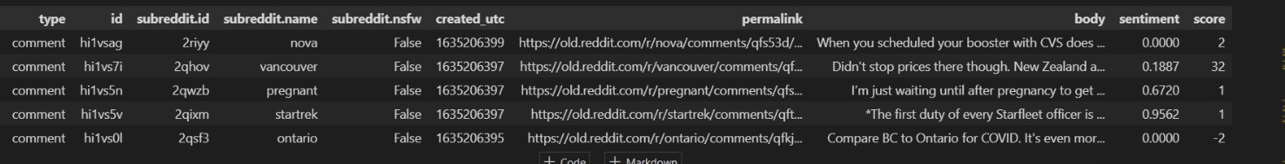
COVID Reddit Dataset
Type: Indicates the type of data, comments or post (we have only used comments due to insufficient access to computational power
ID: Unique identifier for each data entry
Subreddit ID: Unique identifier for the subreddit associated with the post.
Subreddit Name: The name of the subreddit where the post was made.
Subreddit NSFW: Binary indicator (True/False) denoting whether the subreddit is marked as "Not Safe For Work" (NSFW).
Created UTC: Timestamp indicating when the post was created, in Coordinated Universal Time (UTC).
Permalink: URL link to the specific post on Reddit.
Body: The text content of the data entry
Sentiment: The sentiment expressed in the post, often categorized as positive, negative, or neutral.
Score: The Reddit score or popularity measure associated with the post.

Slide 9
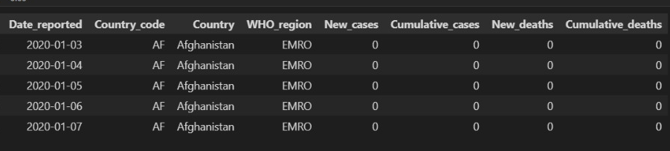
WHO Stats Dataset
Date_reported: The date when the COVID-19 data for a specific country was reported.
Country_code: A unique code assigned to each country for identification purposes.
Country: The name of the country for which the COVID-19 data is reported.
WHO_region: The World Health Organization (WHO) region to which the country belongs.
New_cases: The number of new COVID-19 cases reported on the given date for a specific country.
Cumulative_cases: The total number of confirmed COVID-19 cases in a country up to the reporting date.
New_deaths: The number of new COVID-19 related deaths reported on the given date for a specific country.
Cumulative_deaths: The total number of COVID-19 related deaths in a country up to the reporting date.

Slide 10
Prior Implementations
Linear Regression & Ridge Regression
R square=1
MSE=0
Overfitting
SVR Regression
R square=0.3252
MSE=0.0001
Underfitting
Decision tree ensemble with KNN
R square=0.7224
MSE=0
Good fit
Random Forests
R square=0.7762
MSE=0
Good fit
Cross validation
Average MSE for Ensemble with KNN=0.00003731281110014121
Average MSE for random forest 0.00001946175304530501; since the average MSE for random forest is lower , its performance is better.

Slide 11

Methodology
1. Data Loading and Inspection
2. Feature Engineering
3. Sentiment Analysis
4. Language Complexity Analysis
5. Combining Data
6. Outbreak Percentage Calculation
7. Machine Learning Model (Random Forest Regressor)

Slide 12

Data Loading, Inspection & Feature Engineering
The initial step involves loading essential Python libraries and datasets, aiming to set the foundation for subsequent analysis. Inspection of missing values and dropping irrelevant columns ensures a cleaner dataset for meaningful analysis.
For the feature engineering part of the code, the 'created_utc' column is converted to a datetime format, facilitating the extraction of temporal features. Aggregating comments on a daily basis, aids in summarizing data, providing a more manageable and informative dataset for subsequent analysis.

Slide 13

Sentiment Analysis
Objective:
Extracting emotional tone from comments.
Natural Language Processing (NLP) techniques are used to analyze the sentiment of textual data.
The sentiment scores provide insights into the prevailing public perception and emotional responses related to COVID-19.
The resources used are:-
vader_lexicon
Punkt
Stopwords
The Sentiment Intensity Analyzer (sid) is loaded, which is a pre-trained model for sentiment analysis provided by NLTK.
Performed on Reddit COVID Dataset.

Slide 14
Steps used in Sentiment Analysis
1) tokenize the words
2) get rid of stopwords
3) convert words into lowercase
4) apply the Sentiment Intensity Analyzer model (SID) to get the sentiment scores
Output: Positive sentiment may correlate with optimism or improving conditions, while negative sentiment may indicate concerns or worsening situations.

Slide 15

Temporal Analysis
Its used to gain a granular understanding of the temporal dynamics of COVID-19
Helps to understand trends, patterns and potential spikes.
We have gone for a daily granularity for the months of September and October 2021
Assumed population of 7.8 billion.
Performed on the WHO Stats dataset

Slide 16
Steps for Temporal Analysis
1)Data preprocessing:
Convert dates into date time format
2)Stats aggregation:
'New_cases': 'sum',
'Cumulative_cases': 'max',
'New_deaths': 'sum',
'Cumulative_deaths': 'max’
3) Percentage Outbreak Calculation:
Cumulative_cases/Total_population*100

Slide 17

Language Complexity Analysis & Combining Data
Tracking language complexity over time can help identify patterns related to information dissemination.A sudden change in complexity might indicate a shift in public engagement or the emergence of new topics.These metrics serve as additional features for the machine learning model, contributing to a more nuanced analysis of outbreak dynamics.
Resources used:-
Punkt
Merging daily comments with global COVID-19 statistics aligns data temporally. This integration allows for the exploration of potential relationships between online discussions and disease outbreak dynamics. Temporal alignment is crucial for accurate correlation analysis and prediction model development

Slide 18
Steps for Language Complexity Analysis
1) tokenize comments into sentences and words.
2) calculate average sentence length
avg_sentence_length = len(words) / len(sentences) avg_word_length = sum(len(word) for word in words) / len(words) ttr = len(set(words)) / len(words)
3)percentage outbreak calculation
Cumulative_deaths/ total_population * 100

Slide 19
Machine Leaning Model
The Random Forest Regressor, known for handling complex relationships in data, is employed for its predictive capabilities.
Steps:
1) we use random forest regressor from scikit library
2)parameter used:-
n_estimators=200
max_depth=10
max_features=“sqrt”
random_state=42
3)Model training
4)Model prediction
5)Model evaluation using R Squared and Mean Squared Error

Slide 20
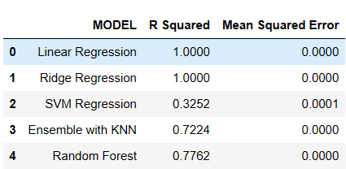
Results and Conclusion

Slide 21
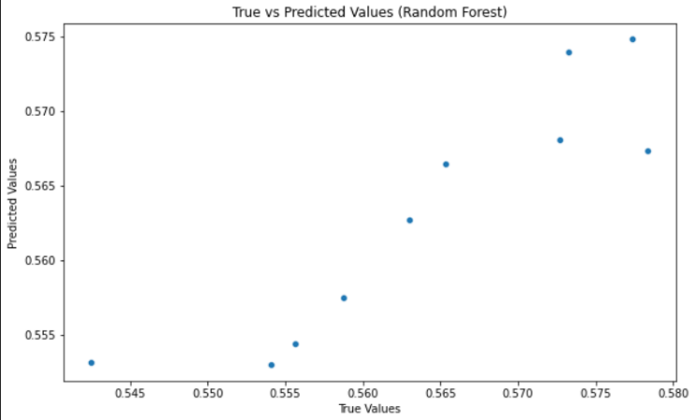
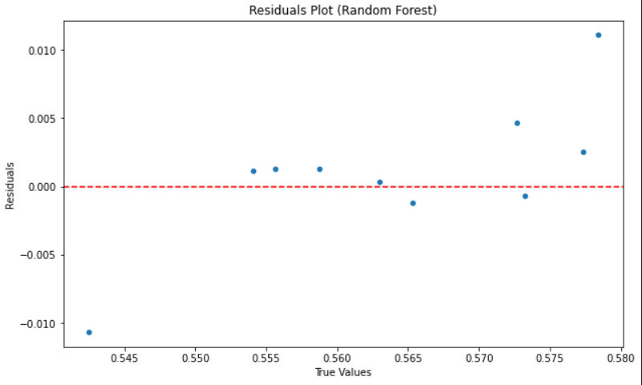

Slide 22
Thank You

